Slide 1
WELCOME
Department of MCA

Slide 2
CROP RECOMMENDER SYSTEM USING
MACHINE LEARNING
Under the guidance of
Mrs. P.Pavitra
Assistant Professor
Department of IT
Student Name : Satyanarayana Merla
Register No : 20L31F0040

Slide 3
CONTENT
  Methodology
  Modules
  UML Diagrams

Slide 4
Methodology
Waterfall Model
Requirement Analysis
Design
Implementation
Testing
Conclusion
Hardware & Software Requirements
Software Requirements Specifications
Data Dictionary
Logical Database Design
UML Diagrams
Selected Software
Sample Code
Test Case1
Test Case 2
Predication
Result
Future Scope

Slide 5
  Modules
Collection of Data Set
Machine learning Algorithms
Crop recommendation
Programming Language

Slide 6
  Collection of Data Set
The dataset which is used for crop recommendation is based on 7 agricultural factors such as N, P, K, temperature, humidity, PH, rainfall. Soil quality is determined by NPK’s value the soil. “N” is nitrogen content in soil, “P” is the content of phosphorus and “K” is the content of potassium the soil.
We have taken 22 different crops to predict best crop from these crops. They are Apple, Banana, Black gram, Chickpea, Coconut, Coffee, Cotton, Grapes, Jute, Kidney Beans, Lentil, Maize, Mango, Moth beans, Mung beans, Muskmelon, Orange, Papaya, Pigeon peas, Pomegranate, Rice and Watermelon.
A data set (or dataset) is a collection of data. We have collected the data set from Kaggle . Kaggle is a platform that allows users to find and publish data sets, explore and build models in a web-based data-science environment, work with other data scientists and machine learning engineers, and enter competitions to solve data science challenges. Kaggle is a subsidiary of google.

Slide 7
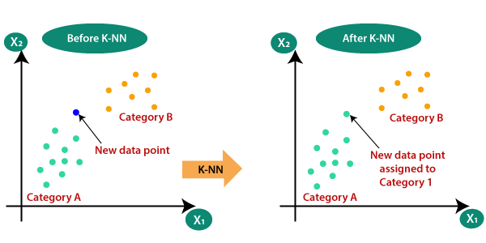
Machine Learning Algorithms
KNN Algorithm
K-Nearest Neighbor is one of the simplest Machine Learning algorithms based on Supervised Learning technique. K-NN algorithm assumes the similarity between the new case/data and available cases and put the new case into the category that is most similar to the available categories.
K-NN algorithm stores all the available data and classifies a new data point based on the similarity. This means when new data appears then it can be easily classified into a well suite category by using K- NN algorithm.
K-NN algorithm can be used for Regression as well as for Classification but mostly it is used for the Classification problems. K-NN is a non-parametric algorithm, which means it does not make any assumption on underlying data.

Slide 8
2.Decision Tree Classification Algorithm
Decision Tree is a Supervised learning technique that can be used for both classification and Regression problems, but mostly it is preferred for solving Classification problems. It is a tree-structured classifier, where internal nodes represent the features of a dataset, branches represent the decision rules and each leaf node represents the outcome.
In a Decision tree, there are two nodes, which are the Decision Node and Leaf Node. Decision nodes are used to make any decision and have multiple branches, whereas Leaf nodes are the output of those decisions and do not contain any further branches. The decisions or the test are performed on the basis of features of the given dataset.
In order to build a tree, we use the CART algorithm, which stands for Classification and Regression Tree algorithm. A decision tree simply asks a question, and based on the answer (Yes/No), it further split the tree into sub trees.

Slide 9
3.Random Forest Algorithm
Random Forest is a popular machine learning algorithm that belongs to the supervised learning technique. It can be used for both Classification and Regression problems in ML. It is based on the concept of ensemble learning, which is a process of combining multiple classifiers to solve a complex problem and to improve the performance of the model. As the name suggests, "Random Forest is a classifier that contains a number of decision trees on various subsets of the given dataset and takes the average to improve the predictive accuracy of that dataset." Instead of relying on one decision tree, the random forest takes the prediction from each tree and based on the majority votes of predictions, and it predicts the final output.
The greater number of trees in the forest leads to higher accuracy and prevents the problem of over fitting.

Slide 10
3.Support Vector Machine Algorithm
Support Vector Machine or SVM is one of the most popular Supervised Learning algorithms, which is used for Classification as well as Regression problems. However, primarily, it is used for Classification problems in Machine Learning.
The goal of the SVM algorithm is to create the best line or decision boundary that can segregate n-dimensional space into classes so that we can easily put the new data point in the correct category in the future. This best decision boundary is called a hyperplane.

Slide 11
Crop Recommendation
Crop Recommender System is a system which suggests multiple crops to cultivate in a field. It suggests crops based on the agricultural factors provided in a dataset. We have considered factors like temperature, N, P, K, Ph, rainfall and humidity. To provide graphical user interface for entering input parameters we have imported PySimpleGUI module.
Crop Recommender System
Please enter the following details
Enter ratio of Nitrogen in the soil :……………..
Enter ratio of Phosphorous in the soil :……………..
Enter ratio of potassium in the soil :……………..
Enter ratio of Temperature value around the Field :……………..
Enter PH value in the soil :……………..
Enter average percentage of Humidity around the field :……………..
Enter average amount of rainfall around the field :……………..

Slide 12
Programming Language
We have used Python programming language for designing and implementing Crop Recommender System. Python is the language which is accepted for Machine Learning. It has a huge number of libraries and frameworks: The Python language comes with many libraries and frameworks that make coding easy. This also saves a significant amount of time. The most popular libraries are NumPy, which is used for scientific calculations; SciPy for more advanced computations; and scikit, for learning data mining and data analysis.
Features of Python Language:
Easy to learn and use
Expressive Language
Interpreted Language
Cross-platform Language
Free and open source
Object-Oriented language
Extensible
Large Standard Library
Embeddable
GUI Programming support
Integrated
Dynamic Memory Location

Slide 13
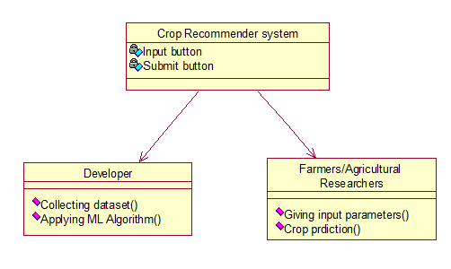
UML Diagrams
Class Diagram

Slide 14
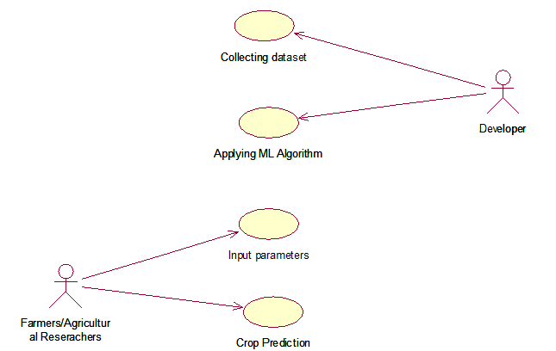
Use case diagram
Use case diagrams are a set of use cases, actors, and their relationships. They represent the use case view of a system.

Slide 15
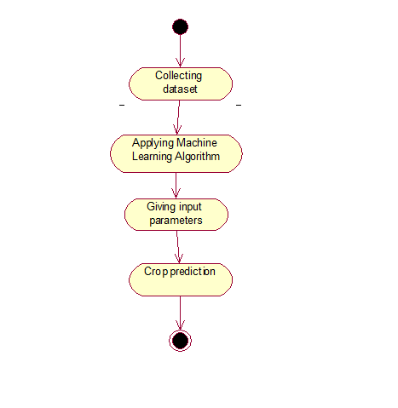
Activity Diagram
It represents the flow of actions performed in our system.

Slide 16
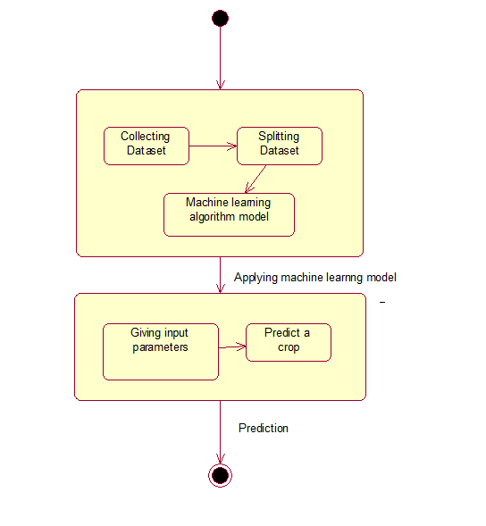
State chart Diagram
A state chart diagram is used to represent the condition of the system or part of the system at finite instances of time.

Slide 17
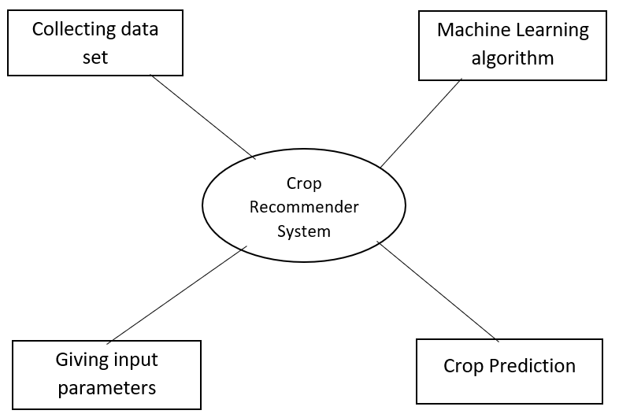
Data flow diagram
A data flow diagram is a way of representing a flow of data through a process or system.

Slide 18
THANK YOU

